Slide 1

Cryptography and Cybercrime: An Overview
Welcome to this overview of basic cryptography and the tools and methods employed in cybercrimes. In this presentation, we will explore the foundational concepts of cryptography, from classical ciphers to modern encryption standards. We will also delve into the darker side of the digital world, examining the various tools and methods used by cybercriminals to compromise systems and steal data. This presentation aims to equip you with the knowledge necessary to understand and defend against these threats.

Slide 2
Data Encryption Standards
DES
AES
The Data Encryption Standard (DES) is a symmetric-key block cipher algorithm. Despite its age and relatively short key length, DES has played a significant role in the history of cryptography.
The Advanced Encryption Standard (AES) is a symmetric-key encryption algorithm widely used today. AES is considered much more secure than DES and is employed in a variety of applications, including securing wireless communications and encrypting data at rest.
Data encryption standards are crucial for protecting sensitive information in transit and at rest. Algorithms like DES and AES use mathematical formulas to transform plaintext into ciphertext, rendering it unreadable to unauthorized parties. AES is favored for its robust security and efficiency.

Slide 3
Public Key Cryptography
1
Key Pairs
2
RSA
3
Digital Signatures
Public key cryptography, also known as asymmetric cryptography, uses key pairs for encryption and decryption. A public key can be shared with anyone, while a private key must be kept secret.
RSA is a widely used public-key cryptosystem that is commonly used for secure data transmission. It is one of the oldest public key cryptosystems.
Digital signatures provide authentication and integrity. The sender uses their private key to sign a message, and the recipient uses the sender's public key to verify the signature.
Public key cryptography enables secure communication without the need to exchange secret keys beforehand. This makes it ideal for secure email, digital signatures, and key exchange protocols. Understanding the principles of public key cryptography is vital for implementing secure systems.

Slide 4
Cryptographic Checksums
MD5
1
Message Digest Algorithm 5 (MD5) is a widely used cryptographic hash function producing a 128-bit hash value. MD5 is used to verify data integrity through one-way hashing.
2
SHA-1
Secure Hash Algorithm 1 (SHA-1) is a cryptographic hash function which takes an input and produces a 160-bit hash value.
SHA-256
3
Secure Hash Algorithm 256-bit (SHA-256) is a cryptographic hash function producing a 256-bit hash value. SHA-256 is used in blockchain technology for securing transactions.
Cryptographic checksums, also known as hash functions, generate a fixed-size output from an input of any size. These are essential for verifying data integrity, ensuring that a file or message has not been tampered with during transmission or storage. Secure checksums prevent malicious alterations.

Slide 5
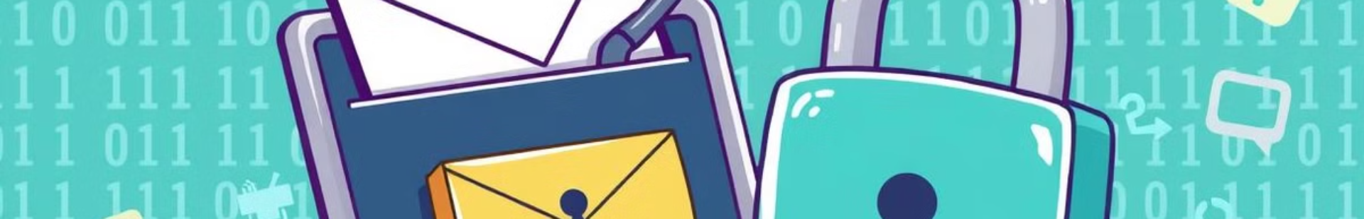



Phishing Techniques
Deceptive Emails
Spear Phishing
Website Spoofing
Cybercriminals often use deceptive emails that appear to be from legitimate organizations to trick users into revealing sensitive information.
Spear phishing involves targeting specific individuals or groups with tailored emails to increase the likelihood of success.
Attackers create fake websites that closely resemble genuine ones to steal usernames, passwords, and financial details.
Phishing is a deceptive technique used by cybercriminals to trick individuals into divulging sensitive information such as usernames, passwords, and credit card details. Recognizing phishing attempts requires vigilance and awareness. Verify sender authenticity and avoid clicking suspicious links.

Slide 6



Password Cracking Methods
2
Brute-Force Attacks
1
Dictionary Attacks
Rainbow Tables
3
Password cracking is the process of recovering passwords from data that has been stored in or transmitted by a computer system. Common methods include dictionary attacks, brute-force attacks, and rainbow tables. Use strong, unique passwords and multi-factor authentication to protect your accounts.

Slide 7




Malware: Viruses and Worms
Viruses
Worms
Trojan Horses
Viruses require a host file to spread and often cause damage to the host system.
Worms are self-replicating malware that can spread across networks without human interaction.
Trojans are disguised as legitimate software but contain malicious code that can harm the system.
Viruses, worms, and trojan horses are common types of malware that can infect computer systems and cause significant damage. Understanding how these threats operate is essential for implementing effective security measures. Keep your antivirus software up-to-date and avoid downloading suspicious files.

Slide 8

Denial of Service Attacks
DoS Attacks
Denial of Service (DoS) attacks flood a target system with traffic, making it unavailable to legitimate users.
DDoS Attacks
Distributed Denial of Service (DDoS) attacks use multiple compromised systems to overwhelm a target, making them harder to mitigate.
Denial of Service (DoS) and Distributed Denial of Service (DDoS) attacks aim to disrupt the availability of online services by overwhelming them with malicious traffic. Mitigation techniques include traffic filtering, rate limiting, and using content delivery networks (CDNs).

Slide 9
Attacks on Wireless Networks
WEP Cracking
1
Older wireless encryption protocols like WEP are vulnerable to cracking.
WPA/WPA2
2
Wi-Fi Protected Access has vulnerabilities that attackers can exploit.
Rogue Access Points
3
Attackers set up fake access points to capture user credentials.
Wireless networks are susceptible to various attacks, including WEP cracking and rogue access points. Protect your wireless network by using strong passwords, enabling WPA3 encryption, and regularly updating your router's firmware. Monitor your network for unauthorized access.

Slide 10
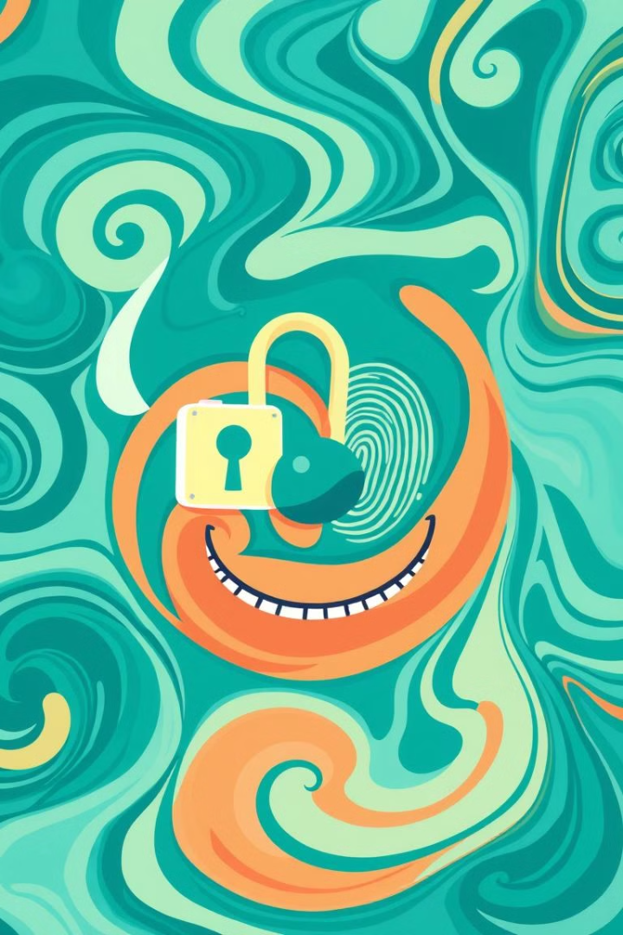
Identity Theft Prevention
Identity theft involves stealing someone's personal information for fraudulent purposes. Safeguard your personal information by shredding sensitive documents, monitoring your credit reports, and being cautious of phishing scams.
In summary, this presentation has covered basic cryptography concepts, common cybercrime techniques, and essential security measures. Staying informed and proactive is crucial for protecting yourself and your organization from cyber threats. Thank you for your attention.

